Slide 1
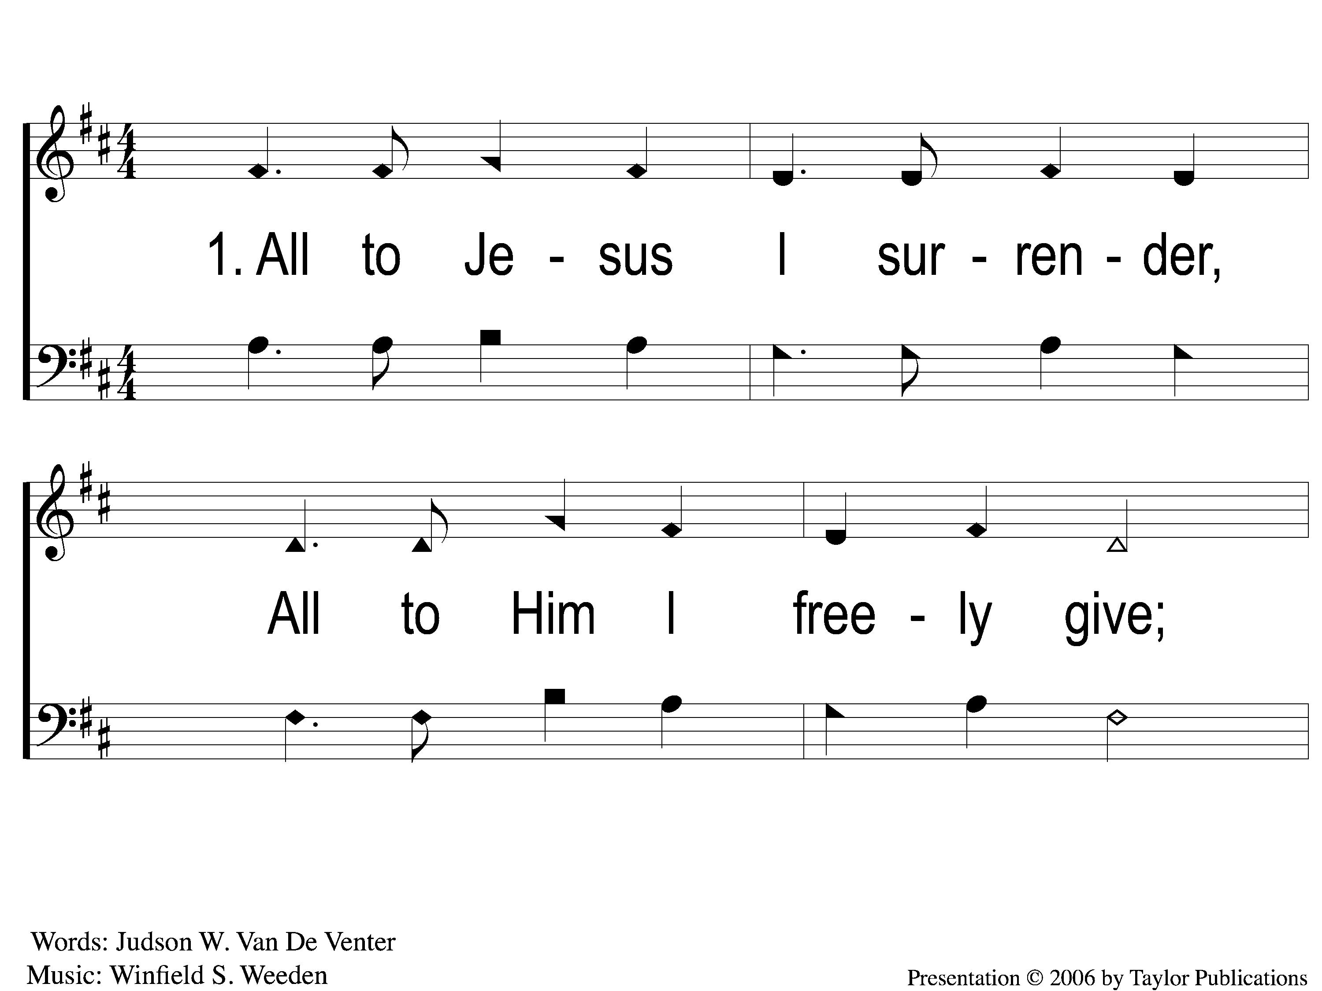
1-1 I Surrender All
I Surrender All
10

Slide 2
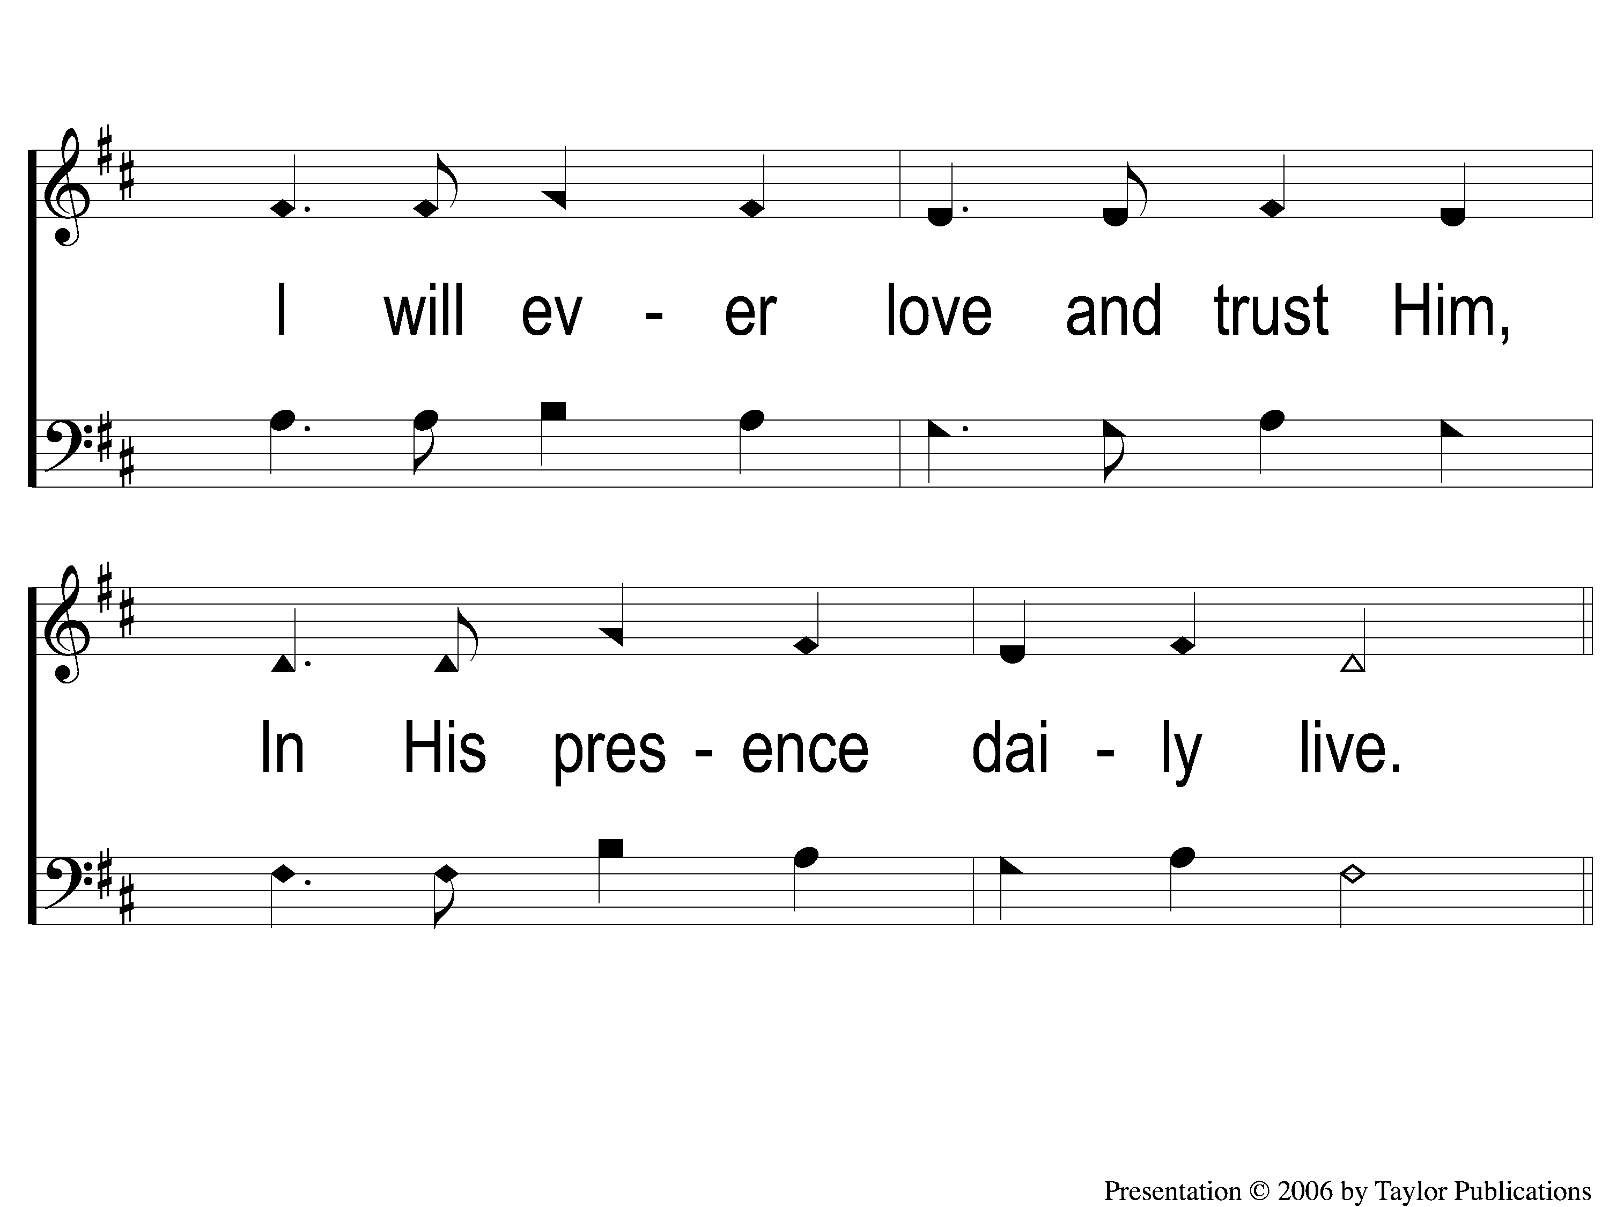
1-2 I Surrender All
I Surrender All
10

Slide 3
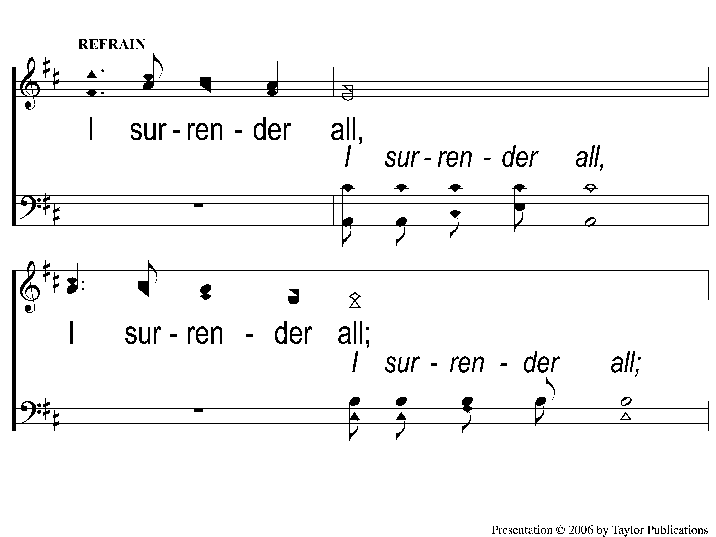
C-1 I Surrender All
I Surrender All
10

Slide 4
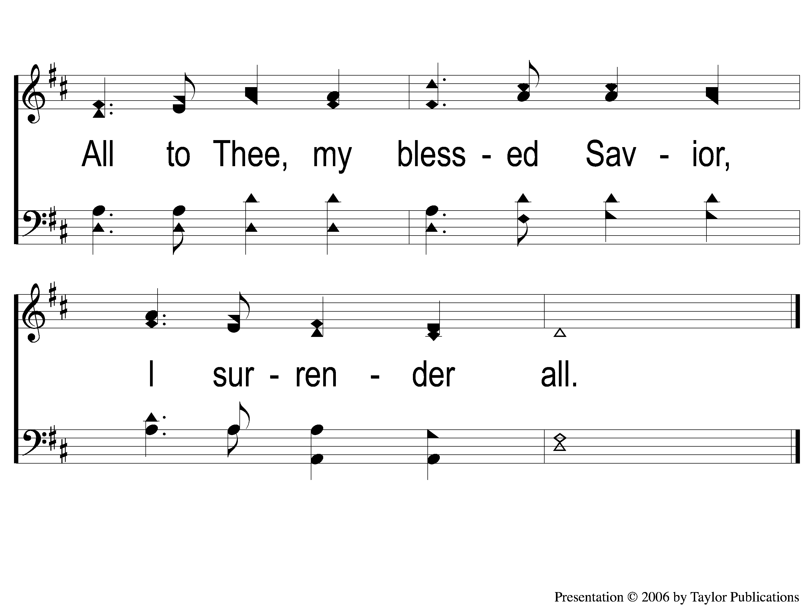
C-2 I Surrender All
I Surrender All
10

Slide 5
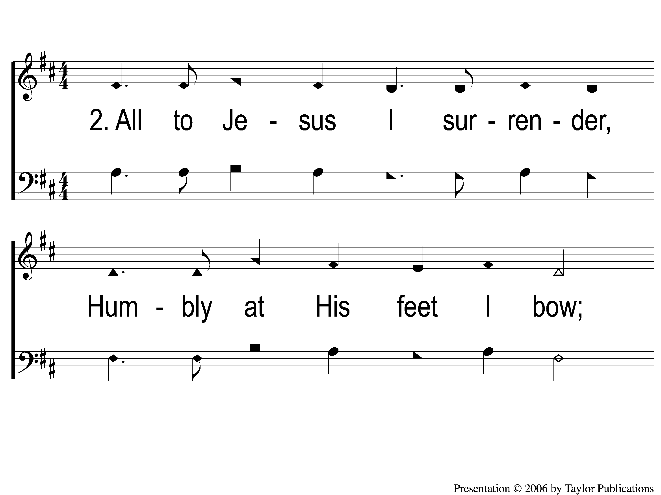
2-1 I Surrender All
I Surrender All
10

Slide 6
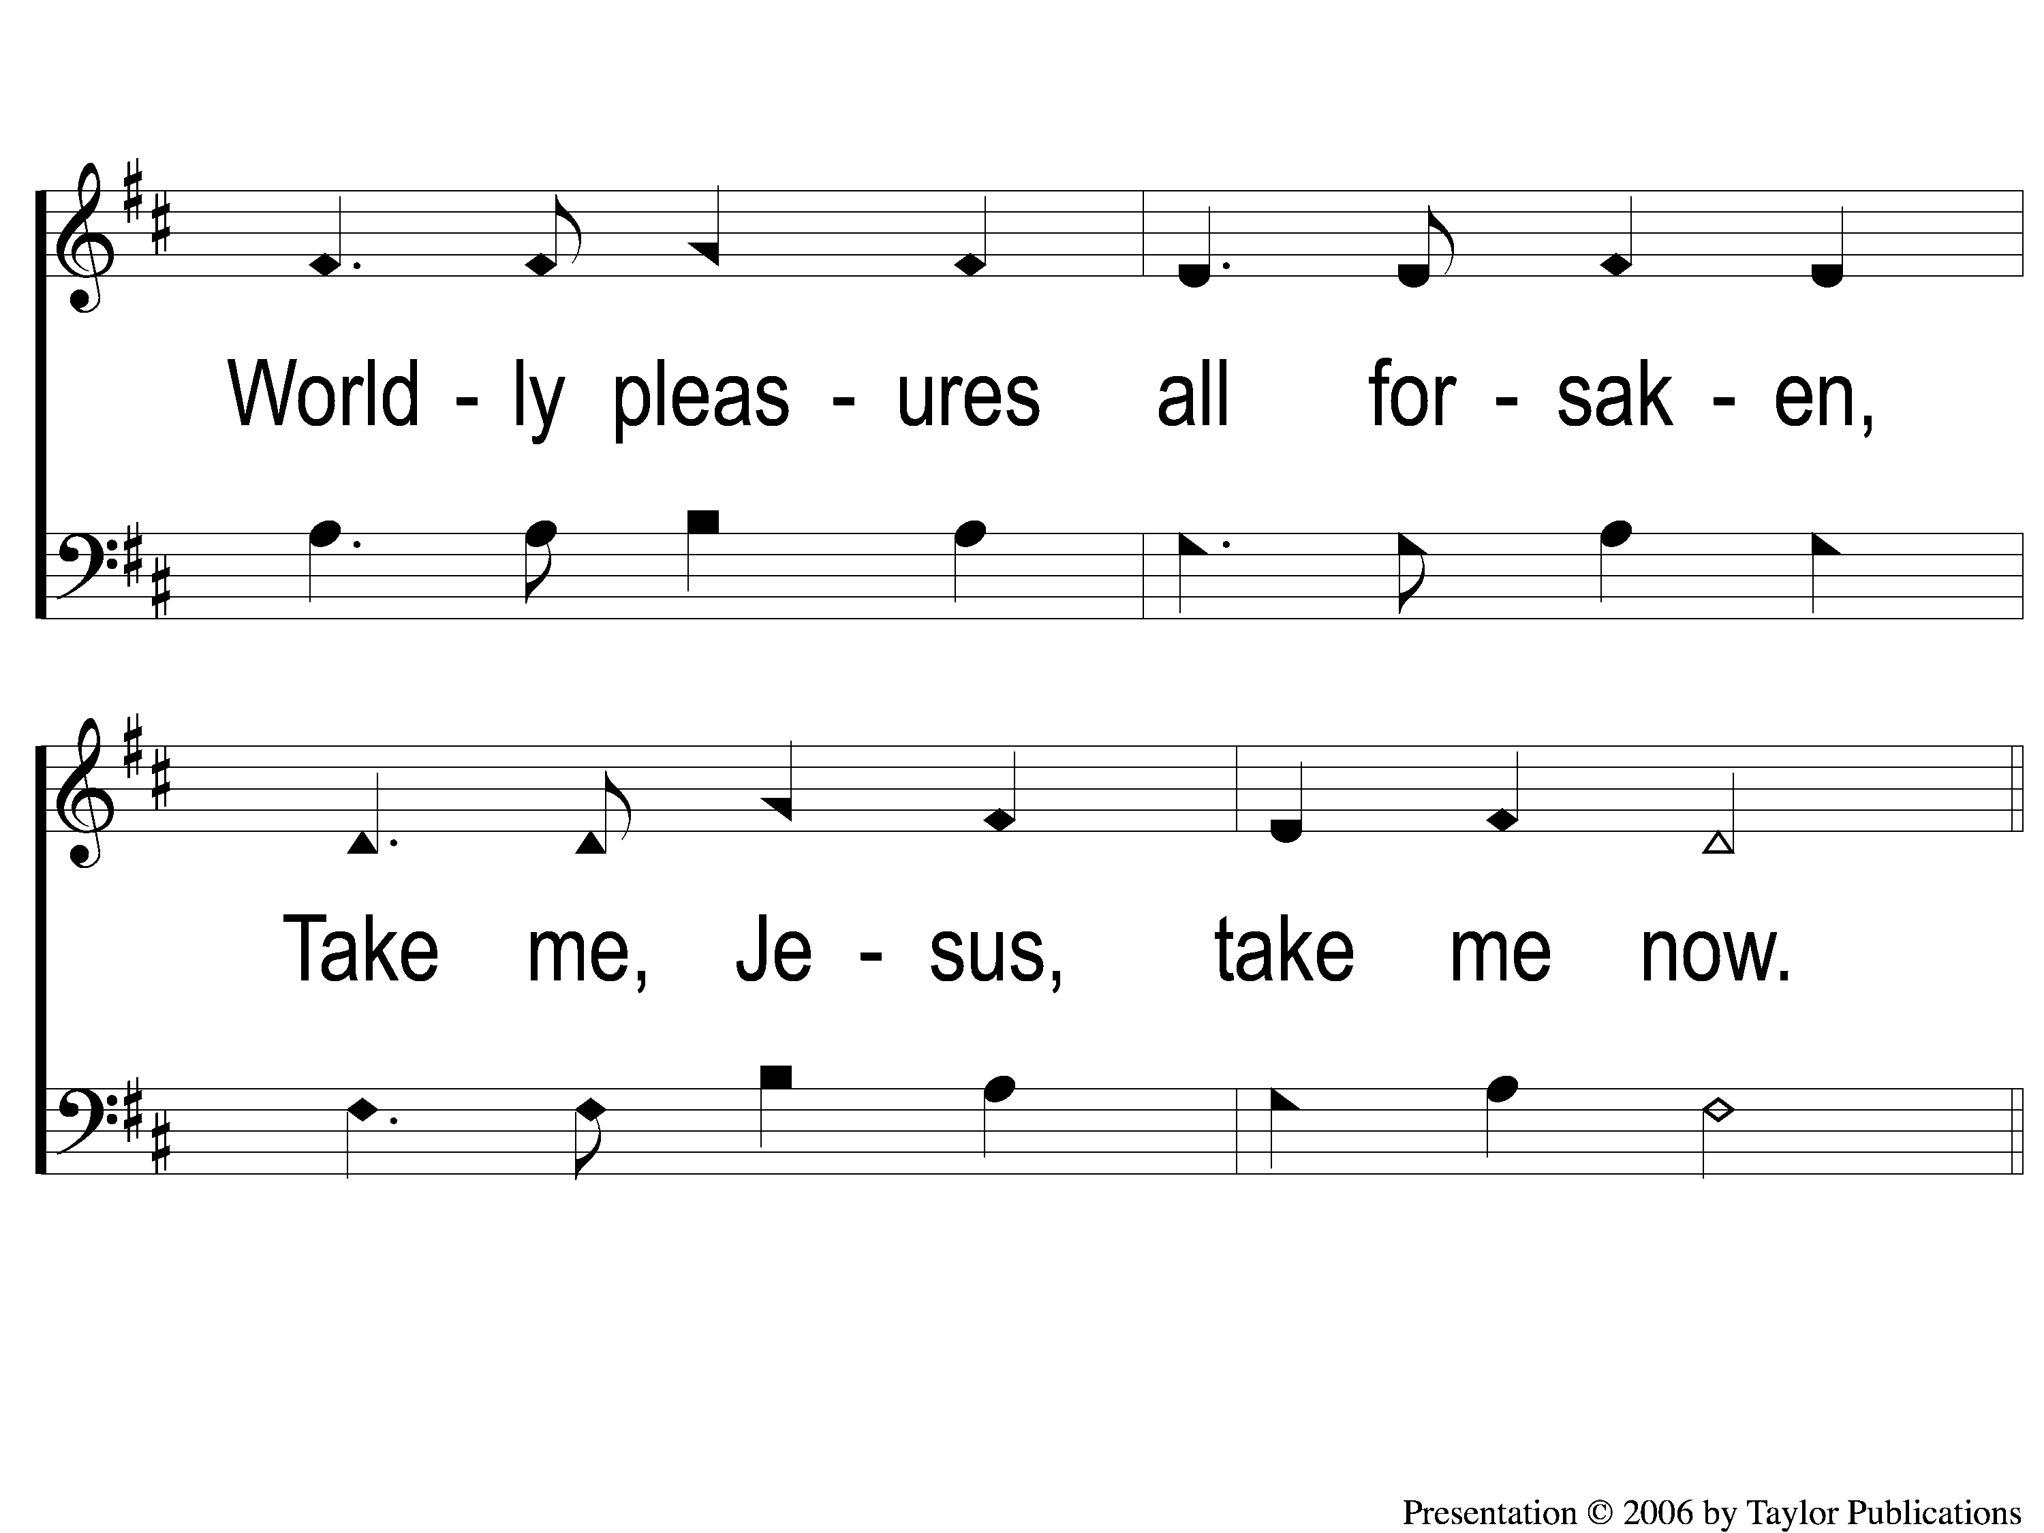
2-2 I Surrender All
I Surrender All
10

Slide 7
C-1 I Surrender All
I Surrender All
10

Slide 8
C-2 I Surrender All
I Surrender All
10

Slide 9
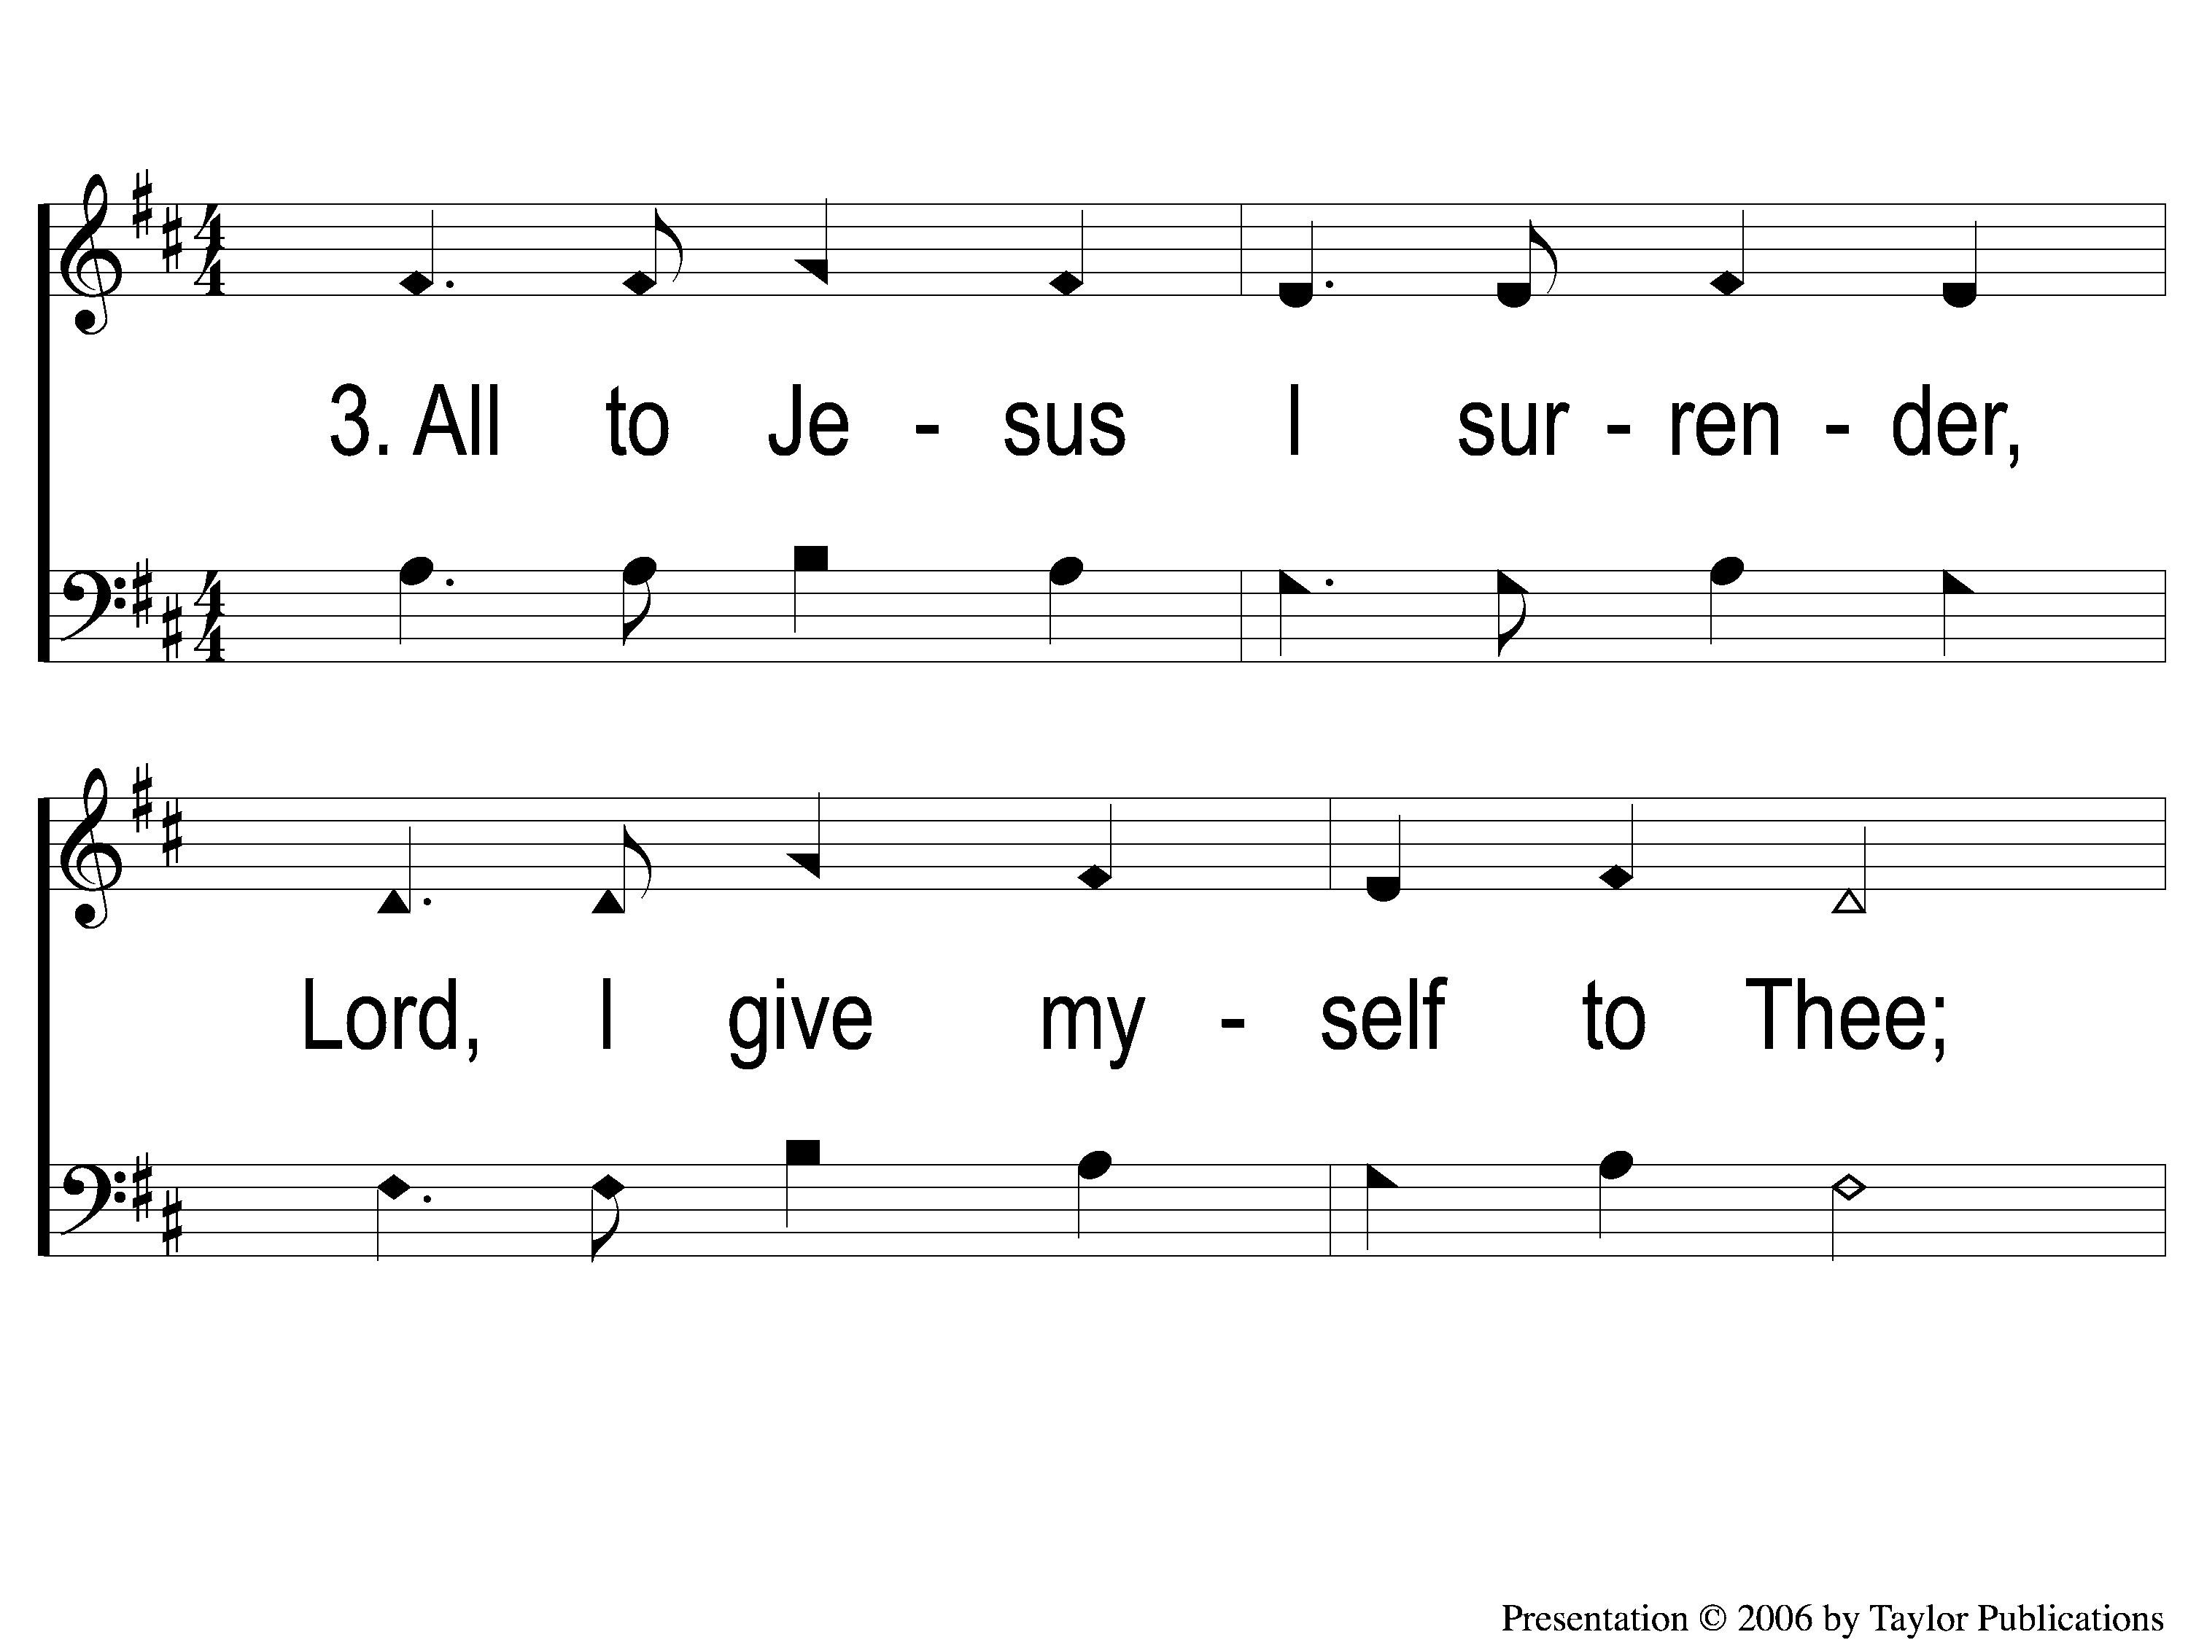
3-1 I Surrender All
I Surrender All
10

Slide 10
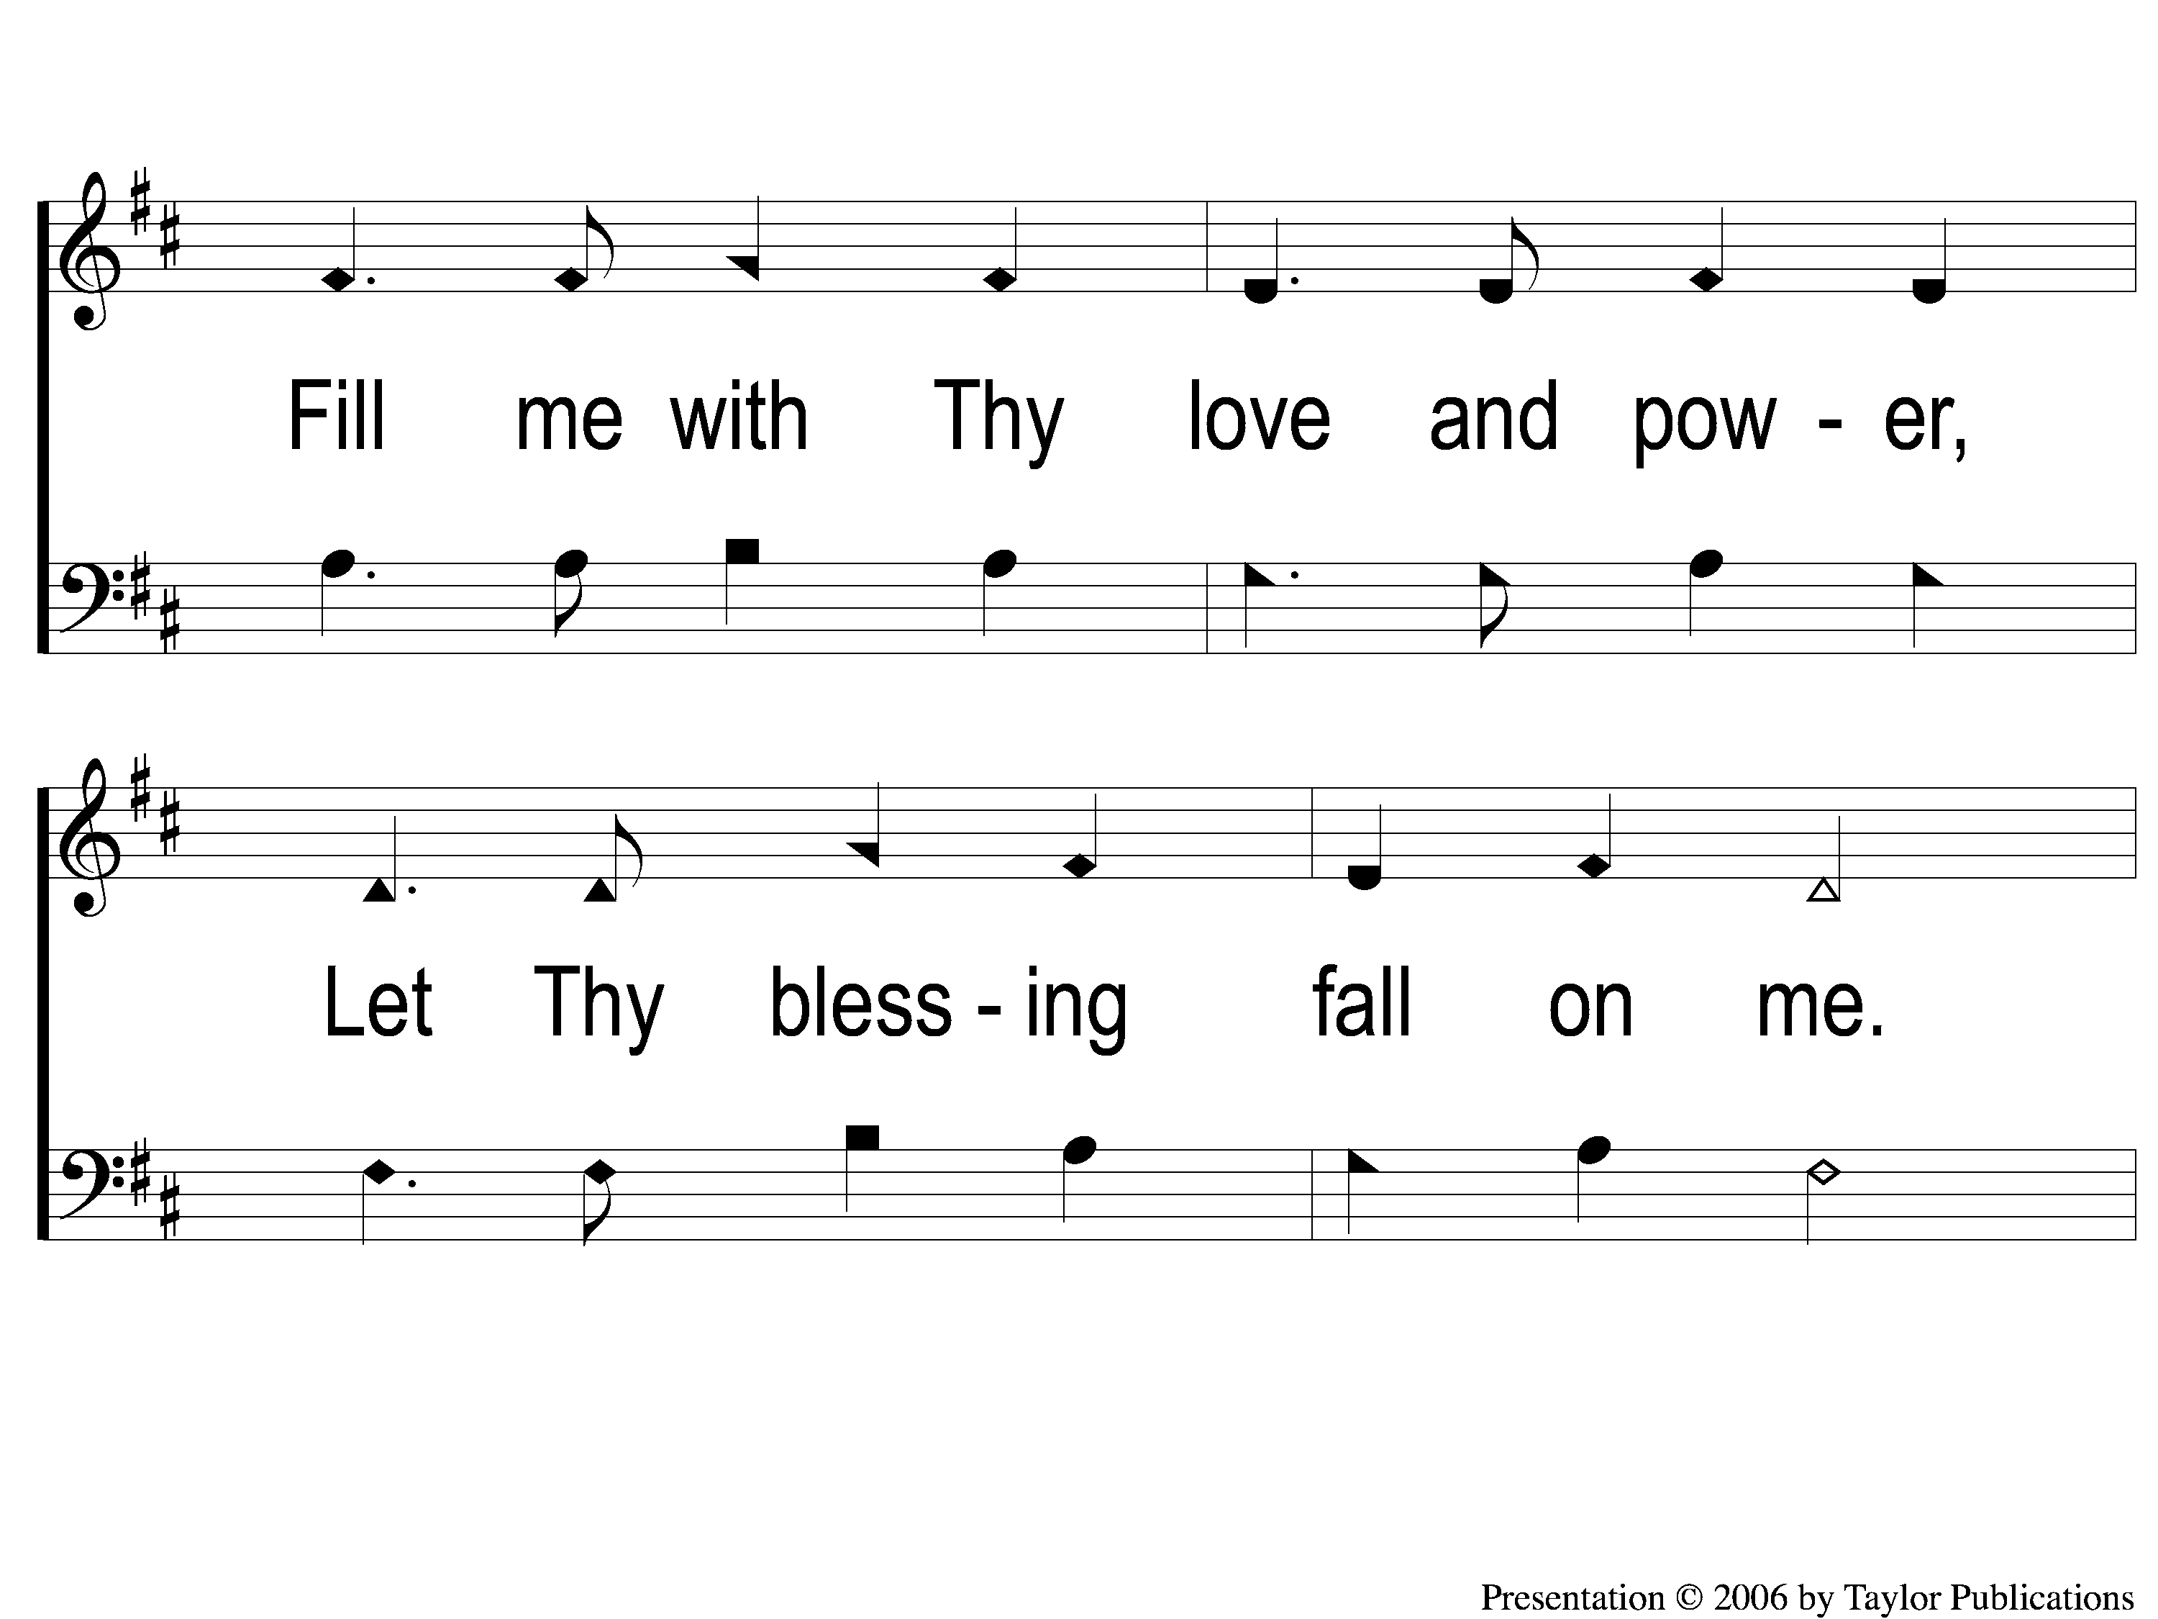
3-2 I Surrender All
I Surrender All
10

Slide 11
C-1 I Surrender All
I Surrender All
10

Slide 12
C-2 I Surrender All
I Surrender All
10

